Slide 1
Fission and heat generation
NE-591

Slide 2
Fission basics
Impinging neutron of a given energy
Neutron energy determines cross section which determines probability of fission event
Neutron + Target Nucleus -> Two fission products, 2-3 neutrons
Fission releases around 210 MeV of energy
170 MeV to fission fragments
2 MeV per neutron
7 MeV gamma rays
Balance radioactive decay

Slide 3
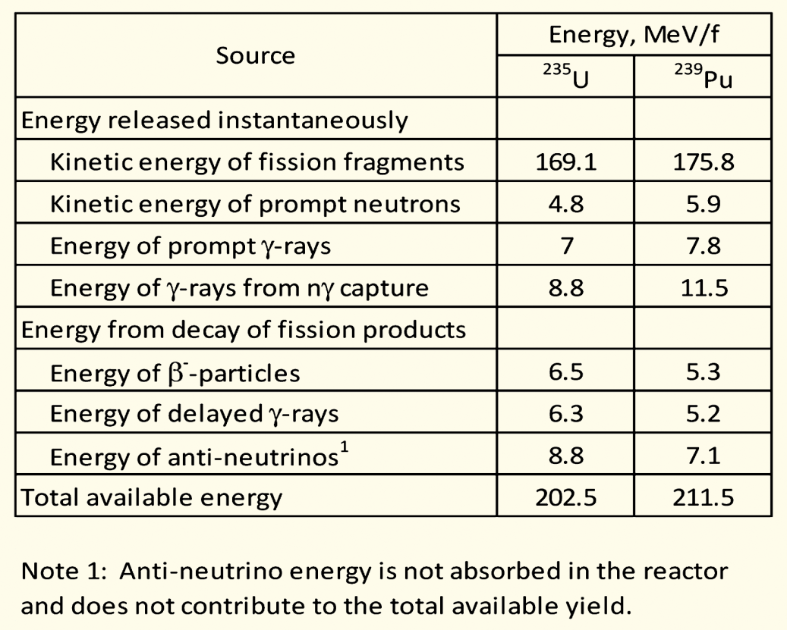
Energy release with different nuclei
Energy release is effectively agnostic with regards to the fissioning species
Comparing U-235 with Pu-239 on the right

Slide 4
Fission product yield
Regardless of fissioning isotope, fission product yields are effectively the same, in this double hump distribution
One broad peak centered around A=95, the other around A=135
Examples:
Mo (Z=42, A=96)
Cs (Z=55, A=133)

Slide 5
Fission Product Yields

Slide 6
Calculating heat generation rate for a given fuel
We know about 200 MeV of energy is available due to a fission (210 MeV minus neutrinos)
We know the fission cross section of the target nuclide (tabulated)
We can calculate the fission atom density
The heat generation rate, Q is given by:
Q = E_{f} x N_{f} x σ_{f} x φ
Where E_{f} is the fission energy, N_{f} is the fission atom density, σ_{f} is the fission cross section, and φ is the neutron flux
Units: J/fission x atoms/cm³ x (fission/neutron)*(cm²/atom) x (neutron/cm²-s) = J/cm³-s

Slide 7
Calculating heat generation rate for a given fuel
Cross sections:
ENDF database: Nuclear Data Sheets 148 (2018) 1–142
Thermal neutron (E=0.025 eV) U235 fission cross section: 586.8 barns
1 barn = 10⁻²⁴ cm²
Fission atom density
Atom density of U-235 = UO2 density x 1/molar mass x Avogadros number x atom fraction x enrichment

Slide 8
Calculating heat generation rate for a given fuel
Given a density of UO2 (10.97 g/cm³)
Enrichment of 3%
Molar mass of 3% enriched UO2
235*0.03 + 238*0.97 + 2*16 = 269.9 g/mol
Atom density of U-235 = 10.97 x 1/269.9 x 6.022E23 x 1/3 x 0.03
2.45E20 atoms/cm³
Given a flux of 5E13 neutrons/cm²/s
Q = E_{f} x N_{f} x σ_{f} x φ
200E6 eV x 1.602E-19 J/eV x 2.45E20 atoms/cc x 587E-24 cm² x 5E13 n/cm²/s
Q = 230 J/s/cm³ = 230 W/cm³

Slide 9
Some notes
Fast neutron cross section ~100x less than thermal neutron cross section
Fuels for fast neutron spectrum typically have high enrichments, 19.7% U-235
Historical research reactor fuels, such as UMo and U3Si2, have had an enrichment of 90+%
Neutron flux will vary depending on the reactor
HFIR has a peak neutron flux of 3E15 n/cm²/s
PULSTAR has a peak neutron flux of 1E13 n/cm²/s
Significant variability in heat generation depending on fuel type and reactor conditions

Slide 10
Reactor Systems
NE 591

Slide 11
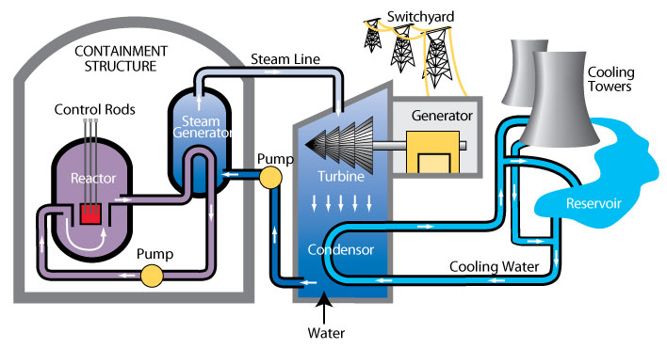
Heat removal systems
Last time, worked though the heat generation rate in the fuel
Now we touch on how heat is removed from the fuel
Primary mechanism to remove heat directly from fuel is a coolant
Various coolant types, most common is water

Slide 12
Heat removal systems
Primary loop water runs through the core, transporting heat generated by the fuel, to a steam generator in a secondary water loop
Steam drives a turbine, generating electricity
A tertiary water loop helps to condense residual steam from the secondary loop via cooling towers and a water reservoir

Slide 13
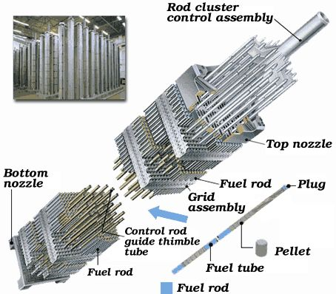
Light Water Reactor Core Design
An LWR core is comprised of fuel assemblies
Each assembly contains a grid of fuel pins
In typical commercial LWR fuel designs, a 17x17 grid
Some pins are replaced by control rods
Water flows from bottom to top

Slide 14
LWR Fuel Pins
LWR fuel pins are comprised of a hollow Zircaloy tube
This is the cladding
Zircaloy is a type of Zr alloy
Inside the cladding are stacked UO2 pellets
Each pellet is a cylinder about 1 cm in diameter and 1 cm in height

Slide 15
Not only water cooled reactor designs

Slide 16
Not all fuel is pellet-based
Metallic fuel is a solid fuel slug
Utilized an Fe-based cladding, such as HT-9 or SS
TRISO particles are formed into spherical compacts, or can be formed into pellet compacts
UMo and USi have been used in plate fuels
Assemblies are often hex-shaped and can included reflectors

Slide 17
ATR and HFIR Core design
HFIR combines curved plates in concentric regions
The ATR core is a unique curved design with plate type fuel

Slide 18
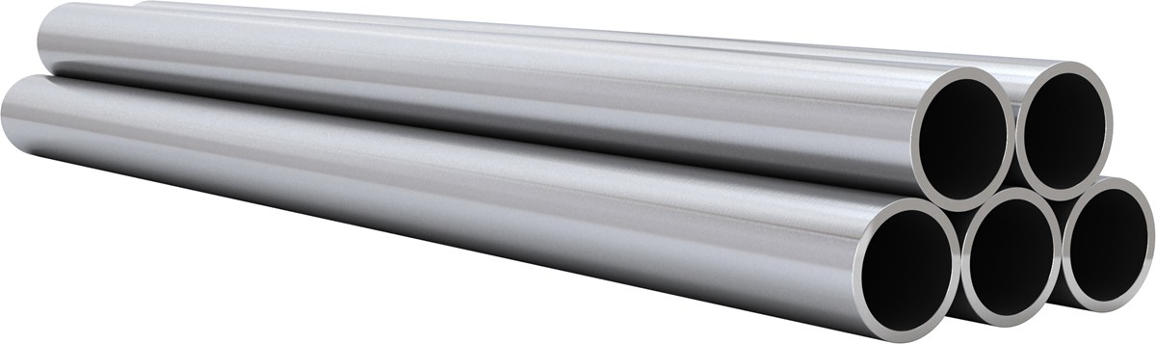
Most fuel designs employ some type of cladding
The primary focus of the cladding is to separate the fuel from the coolant
Fuel contains dangerous fission products
Avoids corrosion of the fuel by the coolant
Keeps the fuel together, not blocking coolant flow
The cladding should be thin and have a high thermal conductivity, so it doesn’t trap any of the heat produced by the fuel

Slide 19
Fuel/Cladding Gap
Fuel swells during reactor operation and the cladding creeps down around the fuel
To avoid/limit both chemical and mechanical interaction, the pellet radius is smaller that the inner radius of the cladding
In LWRs, the gap is filled with gas, significantly impacting the heat transport
In metal fuels, the gap is filled with liquid sodium, so there is little impact on the heat transport

Slide 20
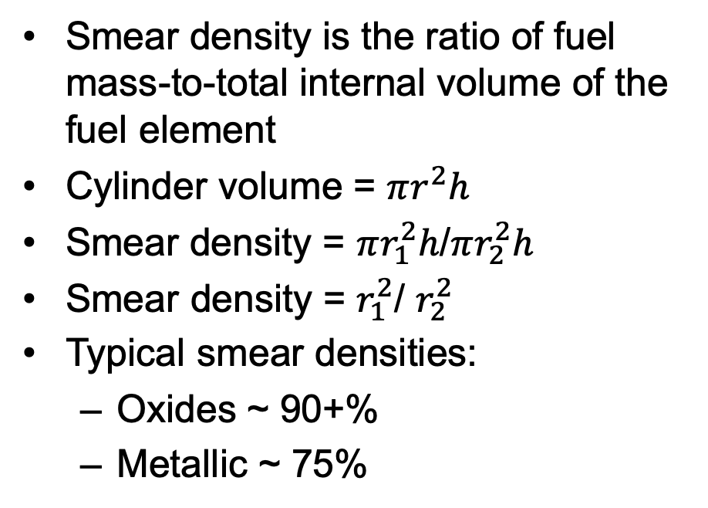
Smear Density
Smear density is the ratio of fuel mass-to-total internal volume of the fuel element
Cylinder volume = $πr^{2}h$
Smear density = $πr_{1}^{2}h$/$πr_{2}^{2}h$
Smear density = $r_{1}^{2}$/ $r_{2}^{2}$
Typical smear densities:
Oxides ~ 90+%
Metallic ~ 75%
r1
H
r2

Slide 21
Cladding material selection
Cladding must be compatible with the coolant, reasonably compatible with the fuel, have good thermal conductivity and reasonable radiation resistance
Zirconium is used because of its
Low neutron cross section
Corrosion resistance in 300 C water
Resistance to void swelling
Adequate mechanical properties
Good thermal conductivity
Affordable cost
Available in large quantities
Other cladding materials in use include
Stainless steel
Silicon Carbide
Ferritic-Martensitic steels like Fe-Cr and Fe-Cr-Al
Oxide dispersion strengthened (ODS) ferritic steels

Slide 22
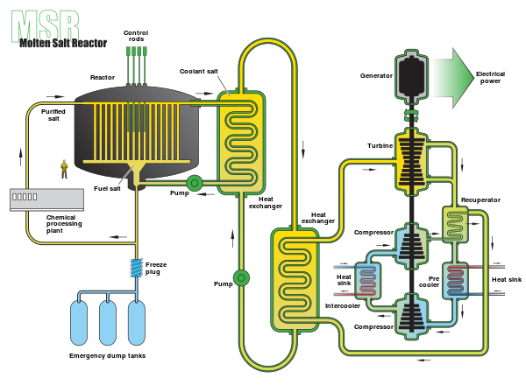
Molten Salt Reactors w/o cladding
Some MSRs plan to utilize liquid UCl3 as the fuel, flowing continuously through the core
Secondary loop comprised of coolant salt, such as LiCl-KCl

Slide 23
Fuel Fabrication

Slide 24
Fabrication Process

Slide 25
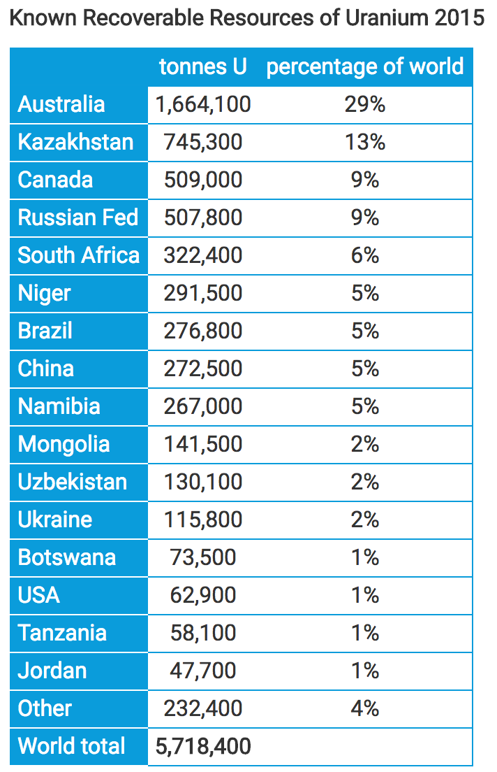
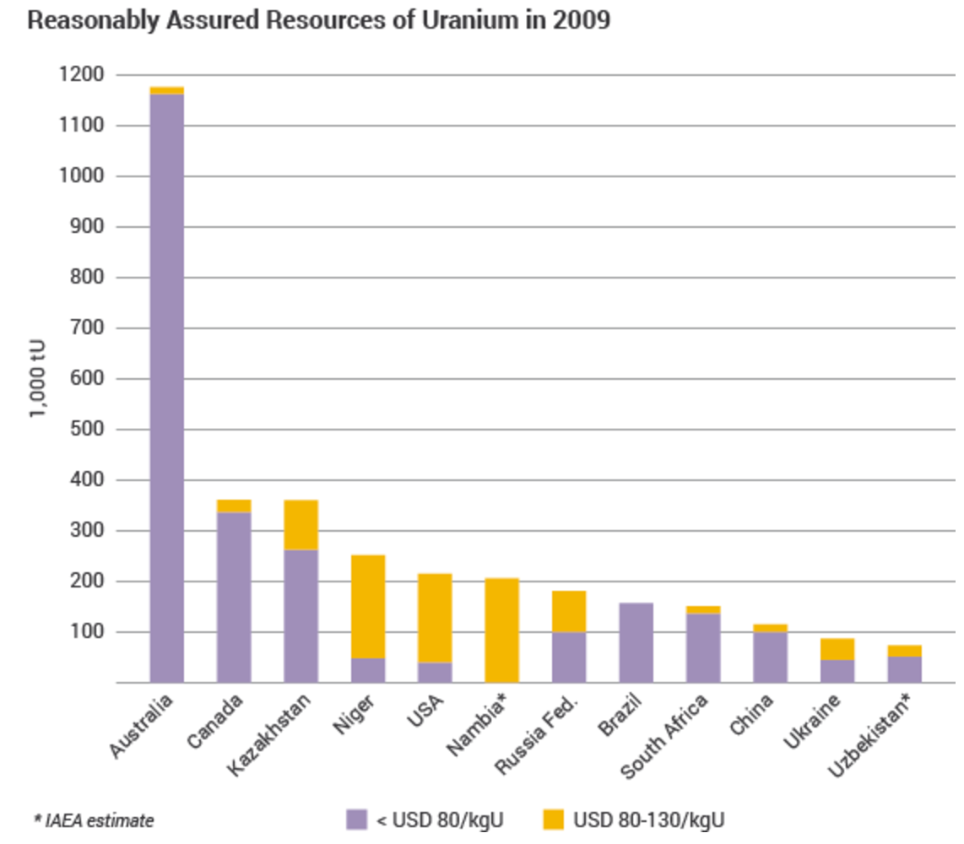
Global Uranium Resources

Slide 26
Uranium deposit types
There are mainly three types of uranium deposits
Sedimentary
Often found in sandstone; common in Canada and western US
Igneous/hydrothermal
Vein-type uranium ores from geothermal activity; Greenland and Namibia
Breccial
found in rocks that have been broken due to tectonic fracturing, or weathering; common in India, Australia and the US
Less common means of uranium mining include seawater recovery, where U concentrations is 3.3 micrograms per liter

Slide 27
Uranium mining/processing
Uranium ores are normally processed by grinding the ore materials to a uniform particle size and then treating the ore to extract the uranium by chemical leaching
The milling process commonly yields dry powder-form material consisting of “yellowcake”, which is U₃O₈

Slide 28
Conversion
Uranium enrichment requires uranium as uranium hexafluoride, which is obtained from converting uranium oxide to UF₆
Uranium oxide can be reduced by hydrogen to produce UO2
U₃O₈ + 2H₂ ===> 3UO₂ + 2H₂O
The oxide is then reacted with hydrogen fluoride to form uranium tetrafluoride (UF4)
UO₂ + 4HF ===> UF₄ + 2H₂O
The tetrafluoride is then fed into a fluidised bed reactor with gaseous fluorine to produce uranium hexafluoride, UF6
UF₄ + F₂ ===> UF₆

Slide 29
Enrichment
Natural uranium only contains 0.7% U-235, and therefore must be enriched to obtain suitable fissile material for fuel (for most reactors)
The difference in mass between U-235 and U-238 allows the isotopes to be separated and makes it possible to enrich the percentage of U-235
Two main enrichment processes
Gaseous diffusion: 2500 kWh per SWU
Centrifuge: 50 kWh per SWU
The capacity of enrichment plants is measured in terms of 'separative work units' or SWU

Slide 30
Enrichment
One ton of natural uranium feedstock might end up: as 120-130 kg of uranium for power reactor fuel, as 26 kg of typical research reactor fuel, or conceivably as 5.6 kg of weapons-grade material
The curve flattens out so much because the mass of material being enriched progressively diminishes, so requires less effort relative to what has already been applied to progress a lot further in percentage enrichment

Slide 31
Enrichment
Enrichment accounts for almost half of the cost of nuclear fuel and about 5% of the total cost of the electricity generated
It is also the main greenhouse gas impact from the nuclear fuel cycle where the electricity used for enrichment is typically generated from coal or natural gas
However, it still only amounts to 0.1% of the carbon dioxide from equivalent coal-fired electricity generation if modern gas centrifuge plants are used

